Slide 1
Digital Portfolio
STUDENT NAME: A.LAWRENCE
REGISTER NO AND NMID: 222404541/90C744787448272AC9149892339148D7
DEPARTMENT: BSC.SOFTWEARE APPLICATION
COLLEGE: COLLEGE/ UNIVERSITY A.M JAIN COLLEGE

Slide 2
PROJECT TITLE DIGITAL PORTFOLIO

Slide 3


AGENDA
Problem Statement
Project Overview
End Users
Tools and Technologies
Portfolio design and Layout
Features and Functionality
Results and Screenshots
Conclusion
Github Link
3/21/2024 Annual Review

Slide 4
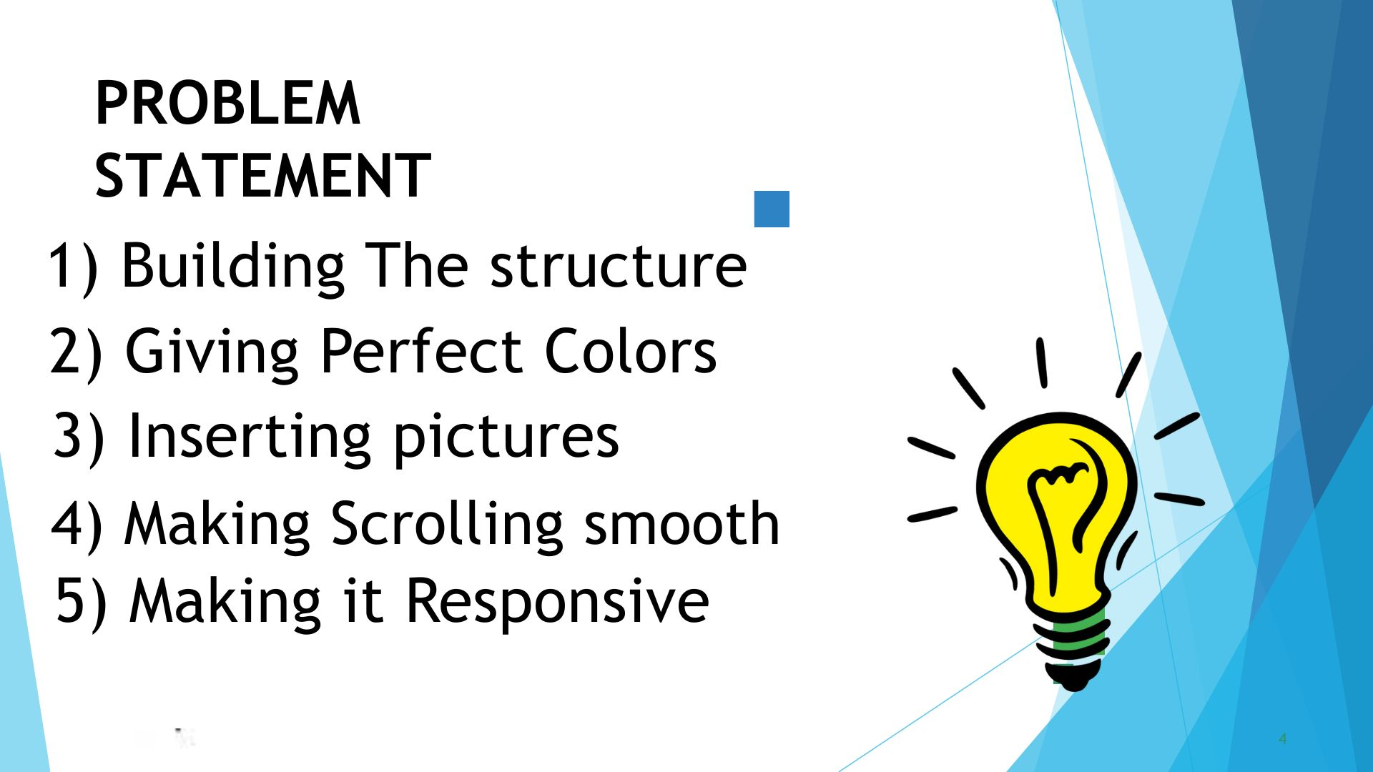

PROBLEM STATEMENT

Slide 5
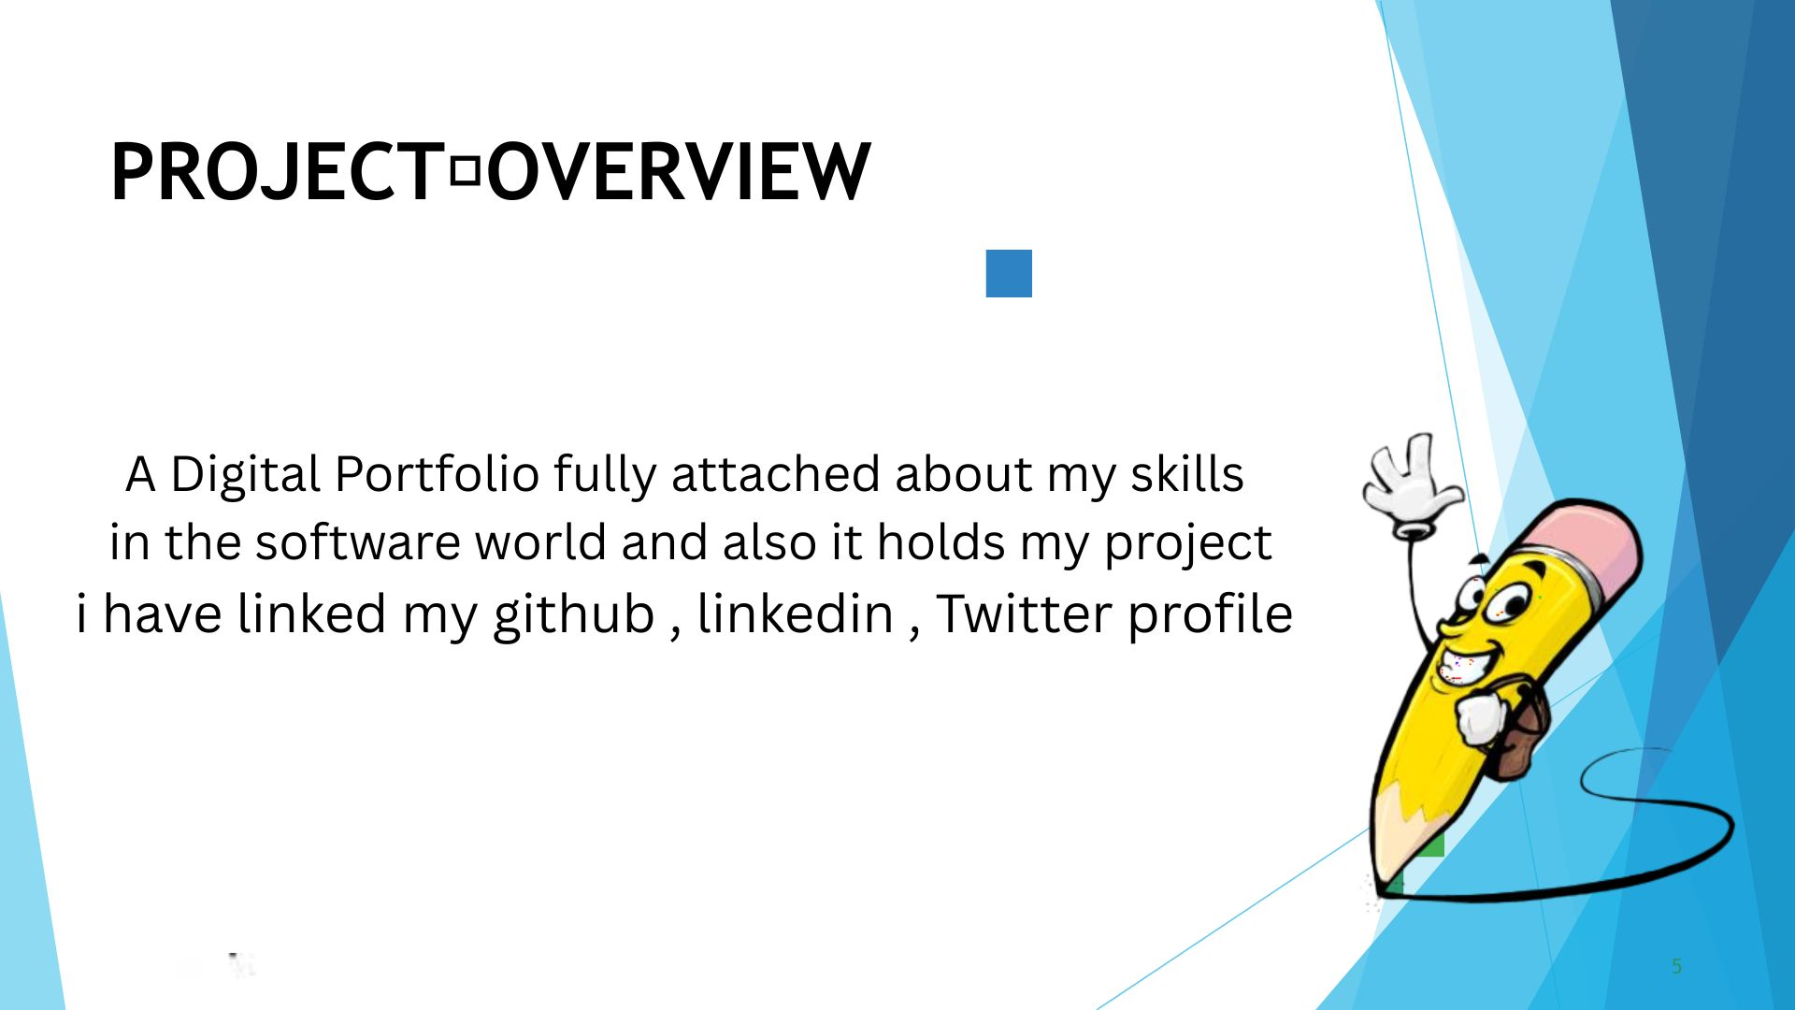

Slide 6
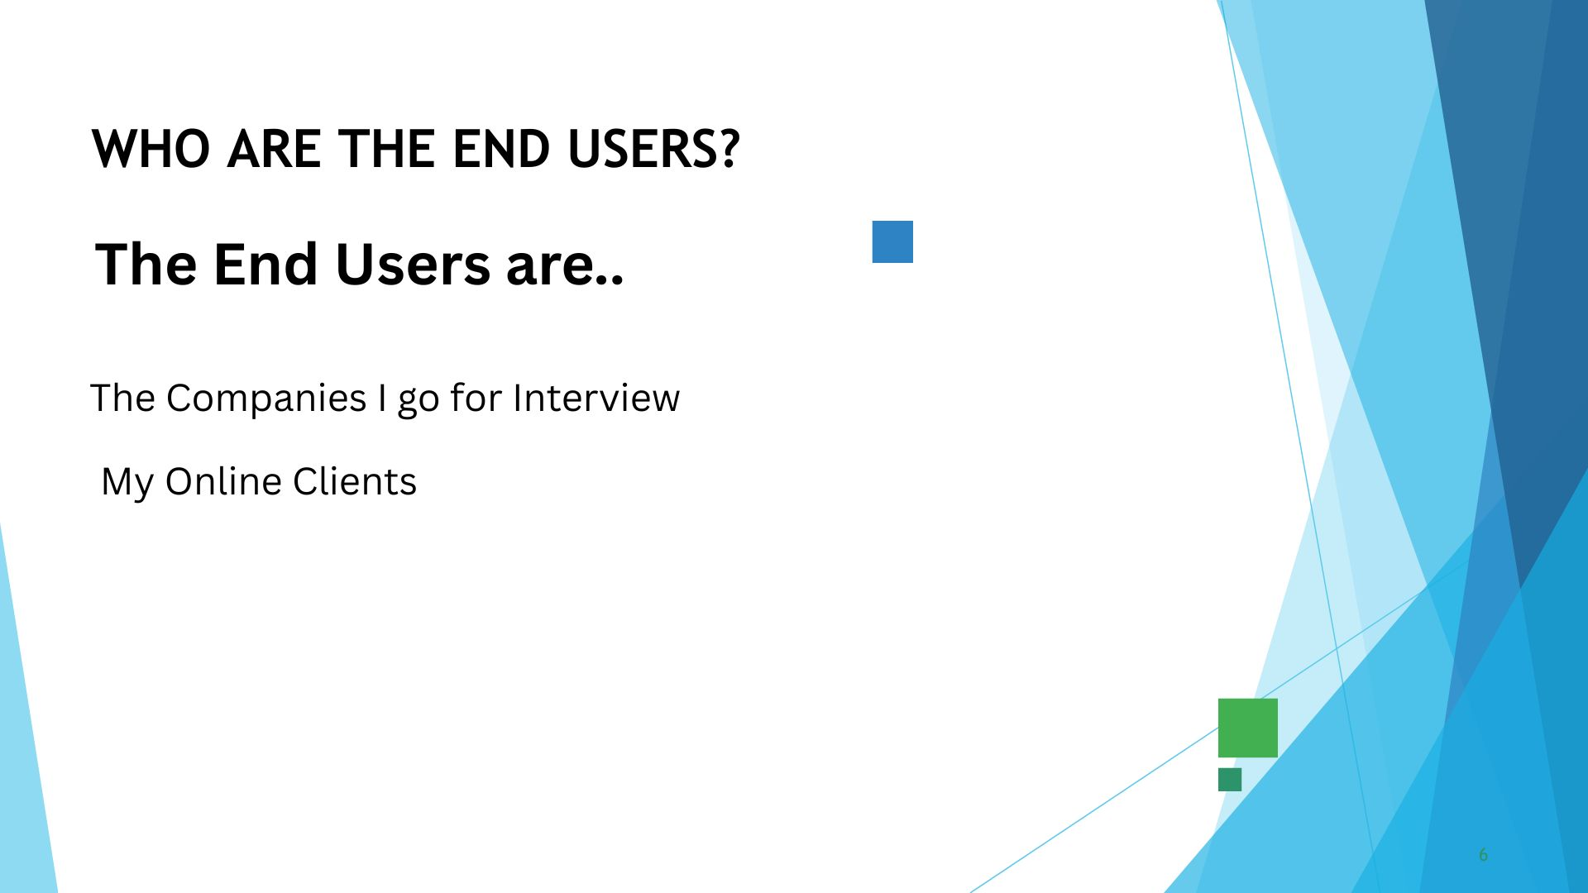

WHO ARE THE END USERS?

Slide 7


TOOLS ANDTECHNIQUES

Slide 8
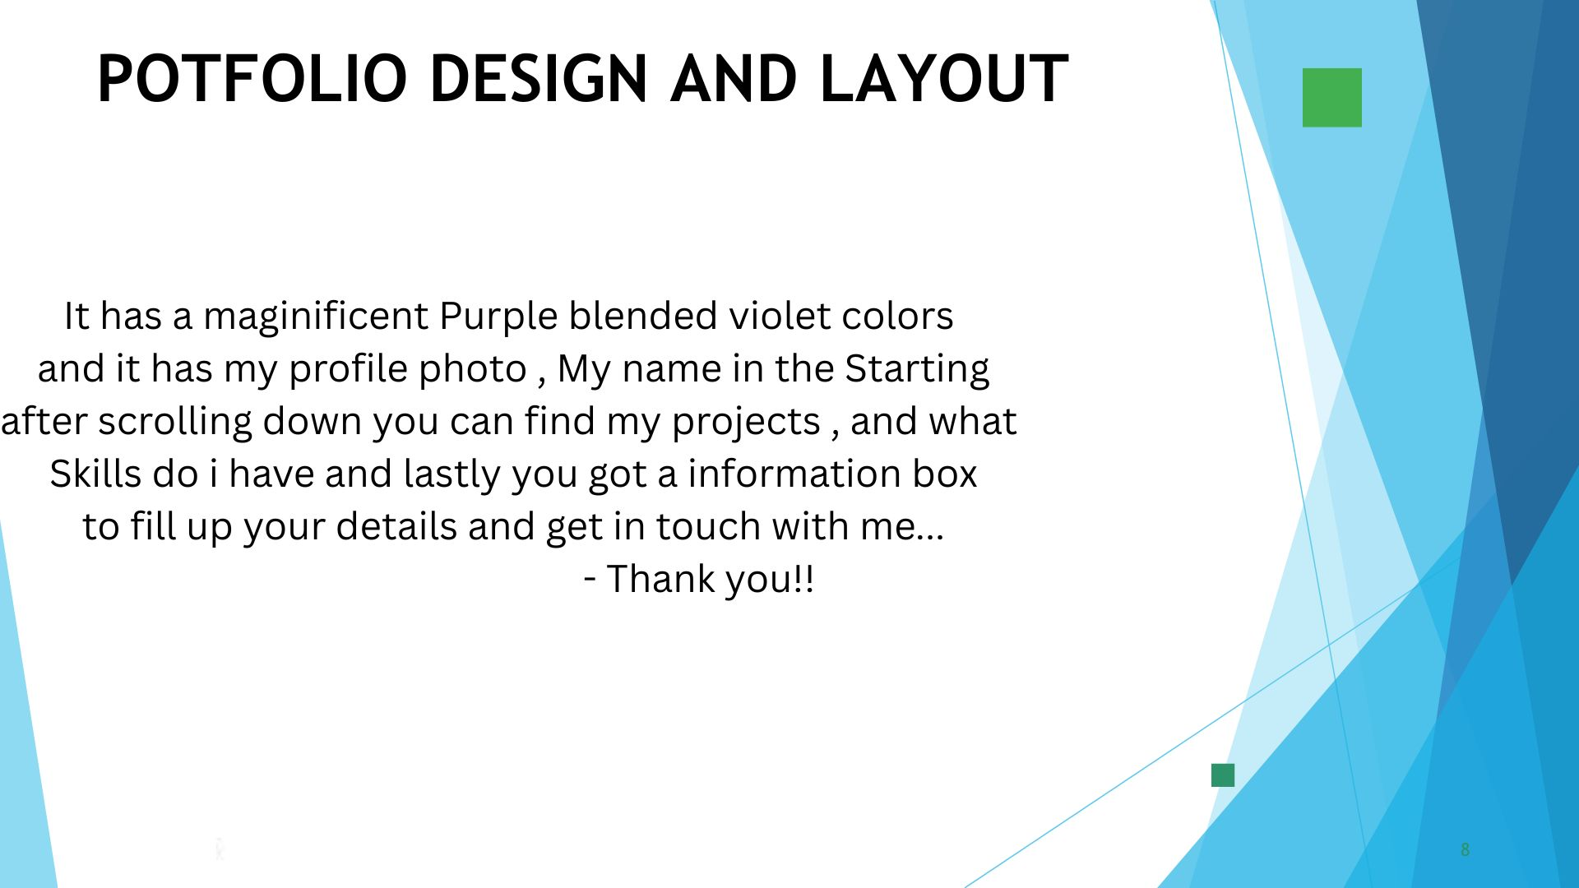
POTFOLIO DESIGN AND LAYOUT
8

Slide 9
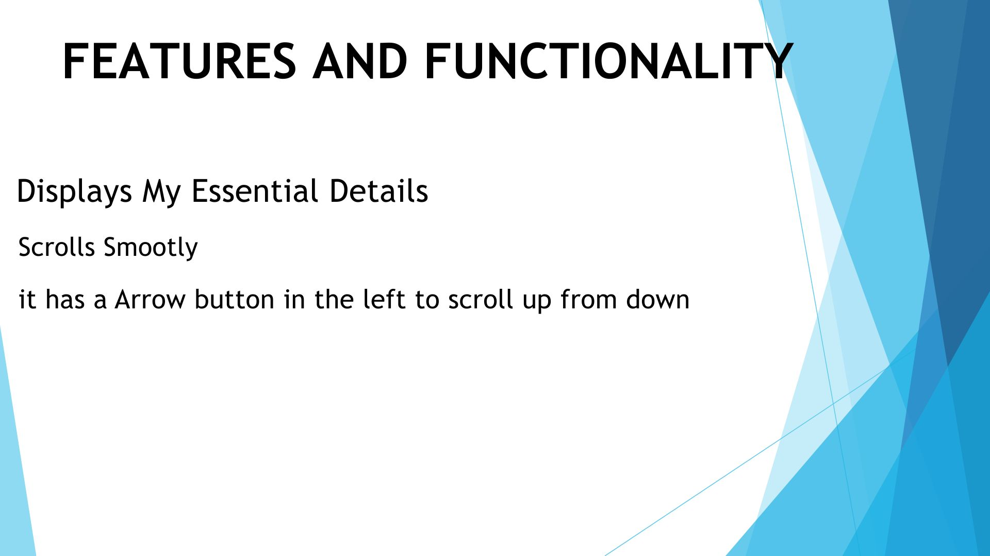
FEATURES AND FUNCTIONALITY

Slide 10
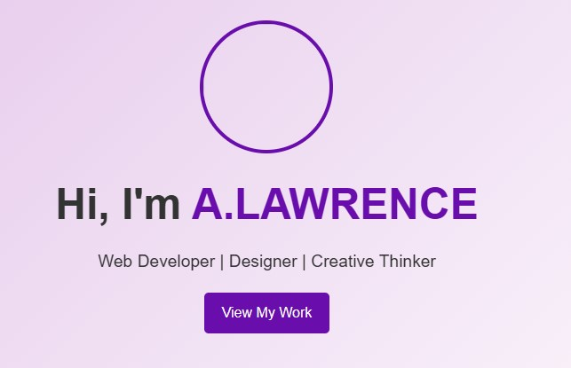
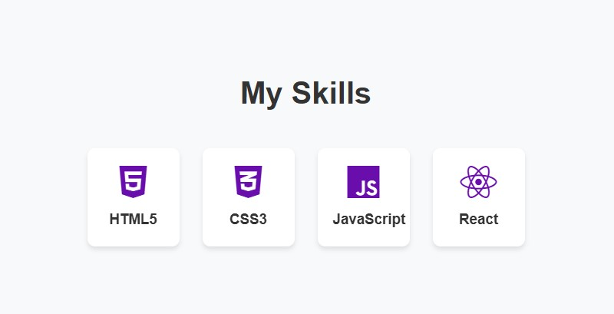

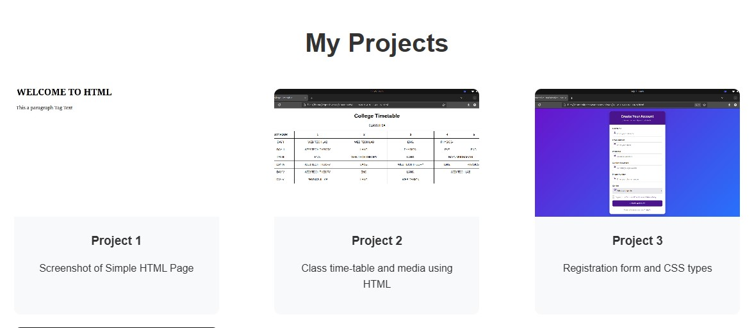
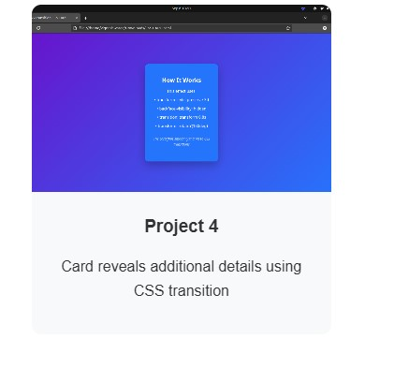
RESULTS AND SCREENSHOTS
3/21/2024 Annual Review
10

Slide 11
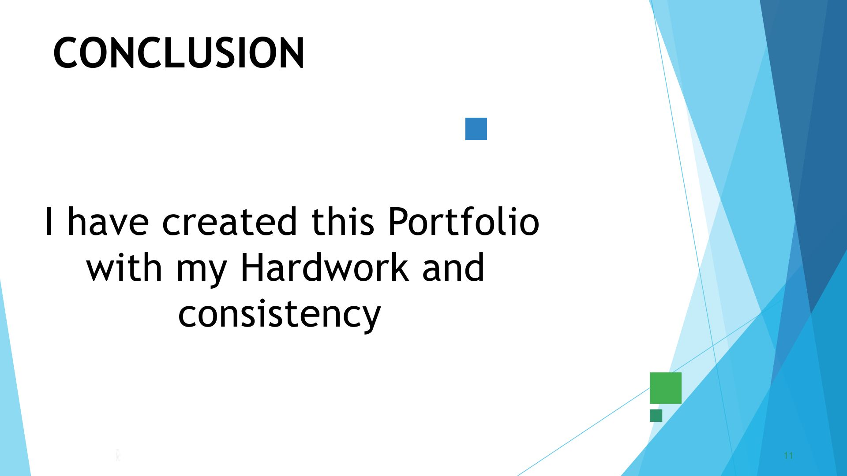
CONCLUSION
Server link:https: https://github.com/LAWRENCE-46/portfolio.git
Deployment link: https://lawrence-46.github.io/portfolio/
11

